Slide 1
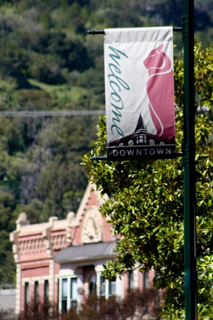
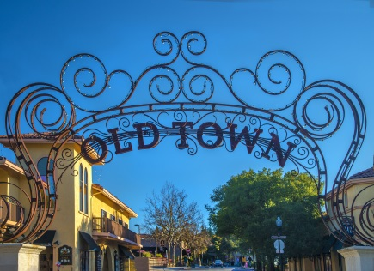
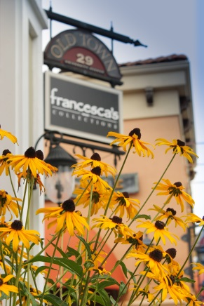
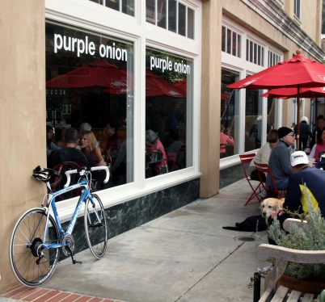

ALMOND GROVE PHASE II UPDATE
Town Council Meeting
December 20, 2016

Slide 2

ALMOND GROVE PHASE II UPDATE:
Trees
Ramps
Utilities Upgrades/Project Phasing

Slide 3


AG II UPDATE
TREES
Established Goals
Goal Achievement

Slide 4
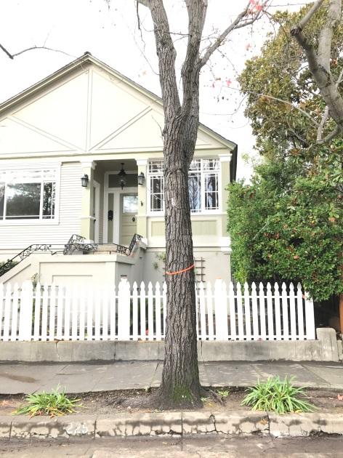
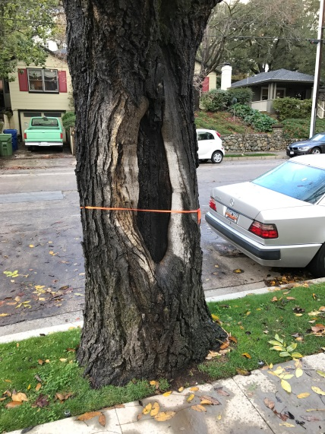
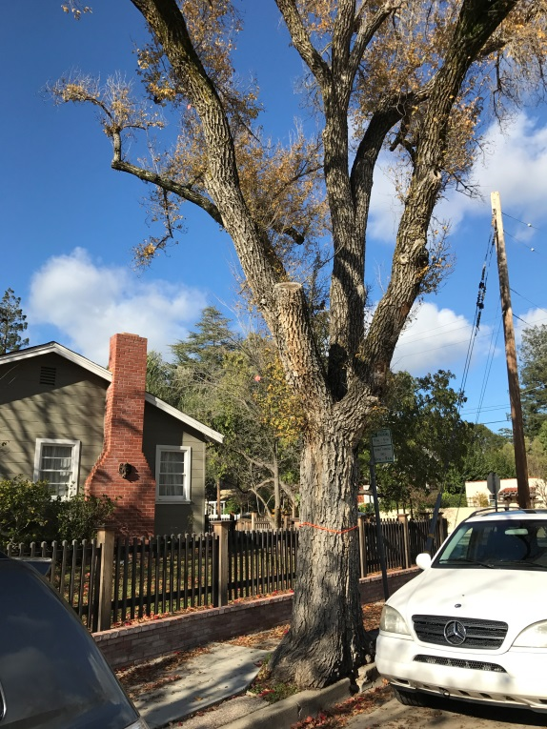
AG II UPDATE
TREES
Examples of Replacements
Internal Rot
Nuisance Tree -
Sweet Gum
In Decline
Damage to Curb/Sidewalk

Slide 5
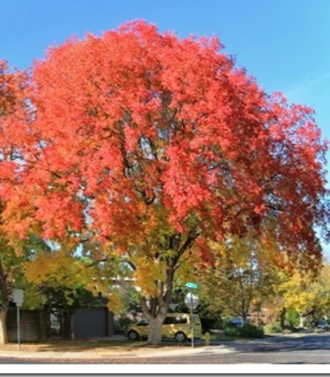
TREES – New and Replacement
AG II UPDATE
Chinese Pistache

Slide 6
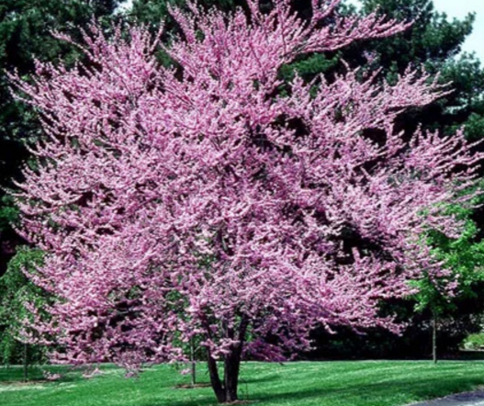
TREES – New and Replacement
AG II UPDATE
Eastern Red Bud

Slide 7
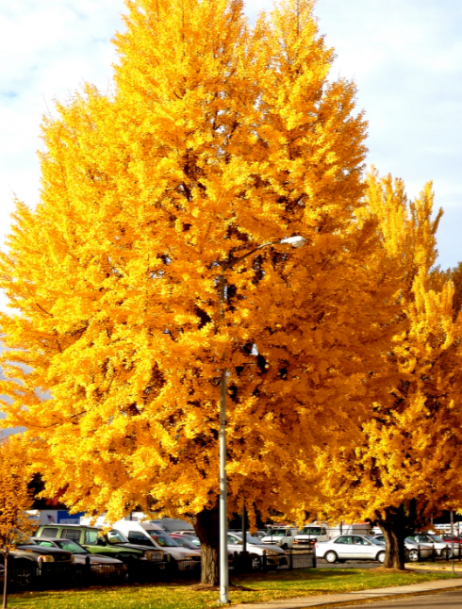
TREES – New and Replacement
AG II UPDATE
Maidenhair

Slide 8
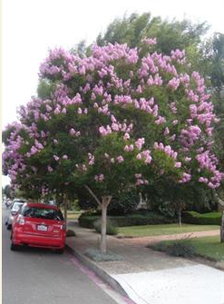
TREES – New and Replacement
AG II UPDATE
Crape Myrtle

Slide 9
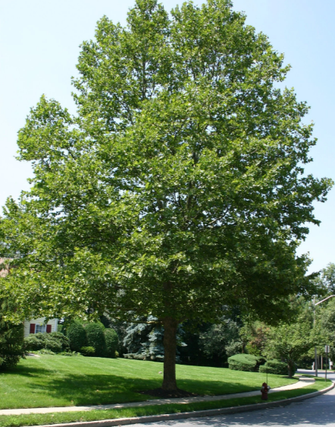
TREES – New and Replacement
AG II UPDATE
London Plane

Slide 10
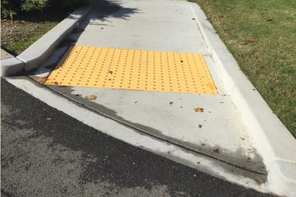
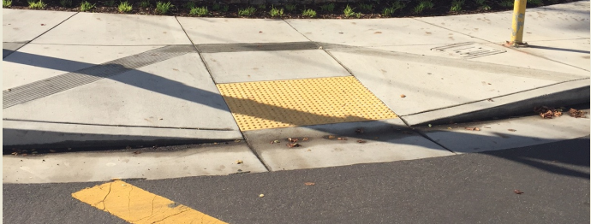
AG II UPDATE
RAMPS
7 Approved Types
Design Direction:
“Build Flared Ramps where Room”
Curbed Ramps
Flared Ramps

Slide 11
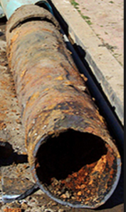
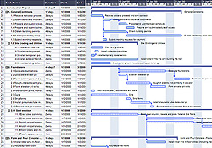
UTILITY/PROJECT STAGING
Utilities Need Work
Staging/ Schedule
Contractor Proposed Schedule
Town Approval Required
2.5 – 3 Streets per year
Fully Complete in 3 Years
AG II UPDATE

Slide 12
NEXT STEPS
Design Completion – January 2017
Council PSE Approval – February 2017
Award of Bid – April 2017
Construction Start (1st Yr) – May 2017
Const. Closeout(1st Yr) – Dec. 2017
AG II UPDATE

Slide 13

QUESTIONS
AG II UPDATE

